Slide 1
Automatic Time Table Generation System
Samdharsi Kumar
Esha Vijayvargiya
Harsh Vyas
Kanishk Sonee
Sneha Yadav
Mayur Singal
Mentor: Neha Patwari

Slide 2
Necessity
Need for effective utilization of resources
A very tedious task but has multidisciplinary applications
Enumeration and other deterministic methods fail
Mostly done manually and is time consuming

Slide 3

The Genetic Algorithm
A simulation of one of the most powerful algorithmic processes found in nature itself

Slide 4

A computational paradigm useful for function optimization inspired from the study of natural processes. They use a population of possible solutions, which are concurrently subject to modifications aimed at the determination of the optimal solution.

Slide 5
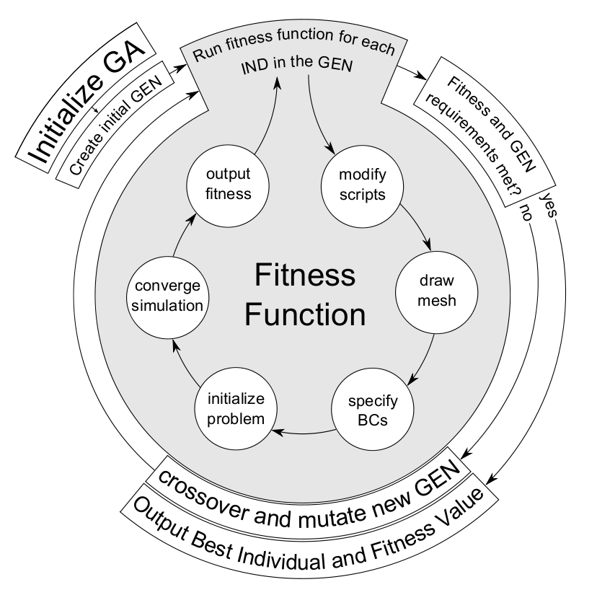

Slide 6
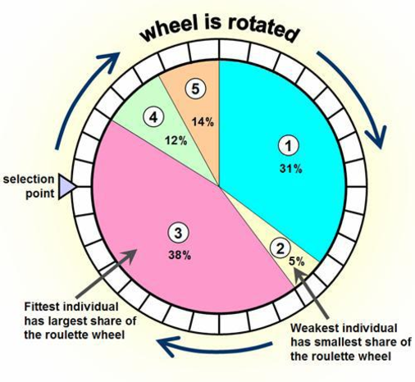

Slide 7
Why this approach?

Slide 8
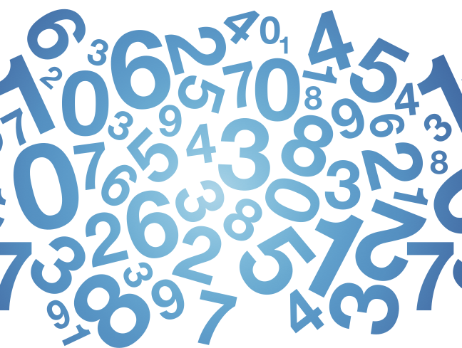

Slide 9
Working

Slide 10
Given these premises, the problem is described by:
• A list of m teachers (10-12 in our case)
• A list of p classrooms involved (10 for the two coupled sections)
• A list of n weekly teaching hours for each class (30)
• The curriculum of each class
• Some external conditions (for example the hours during which some teachers are involved in other sections or activities)

Slide 11
Constraints
• Every teacher and every class must be present in the timetable in a predefined number of hours
• There may not be more than one teacher in the same class in the same hour
• No teacher can be in two classes in the same hour

Slide 12
Classroom
Professors
Lectures
Students
Courses
Constraints
Verification
Regenerate
Timetable

Slide 13
Results

Slide 14
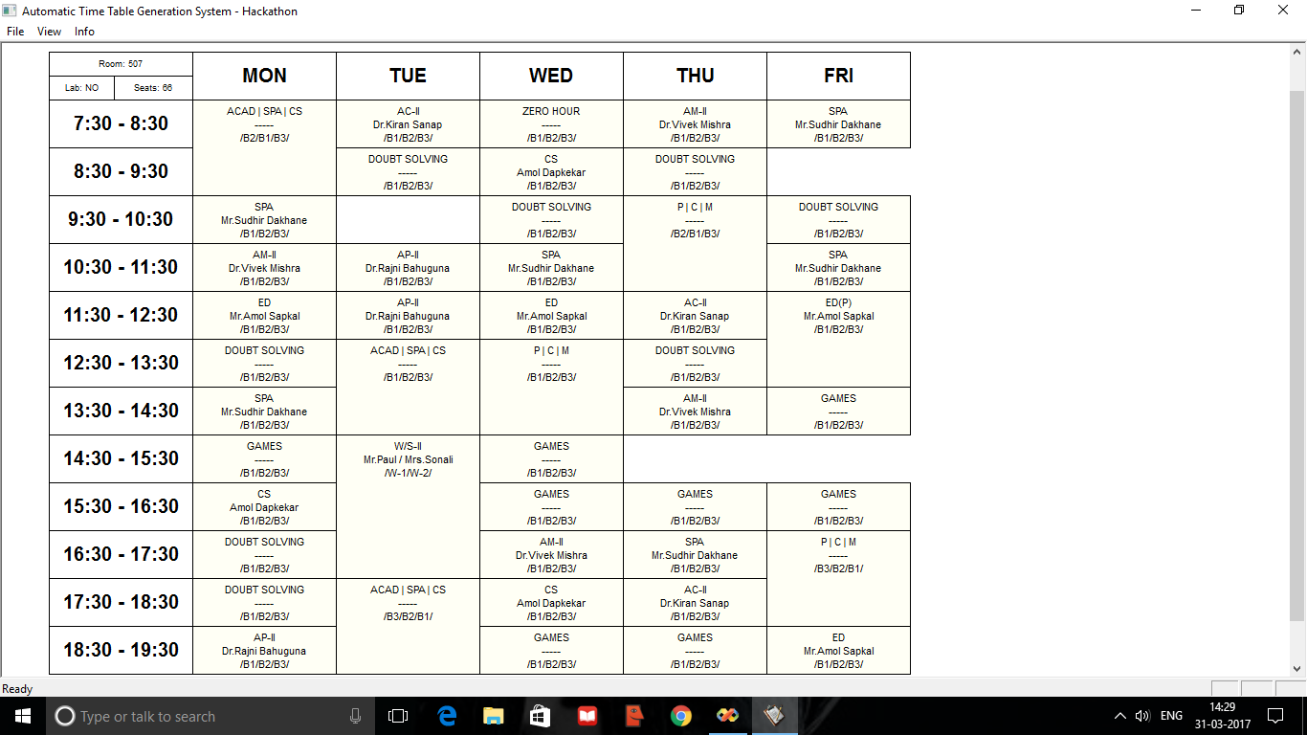

Slide 15
Effectiveness

Slide 16
Possible Improvisations

Slide 17
Conclusions

